Slide 1
What is FPGA?

Slide 2
What is FPGA?
Some people say : Is this a cloud based service, or Arduino like set-up , or PLC like hardware? The answer is: No, its a IC or a Chip.
FPGA stands for Field Programmable Gate Array (FPGA).
It is an Integrated Circuit (IC), that can mimic like any digital circuit. An array of pre-built, hardware gates, which can be configured using Hardware Description Languages(HDL) to act like any Digital Circuit.

Slide 3
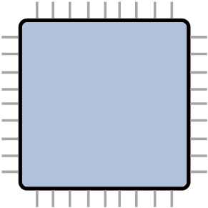
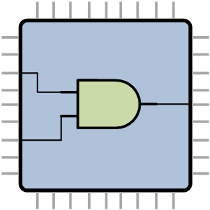
Example
+ HDL Code =

Slide 4
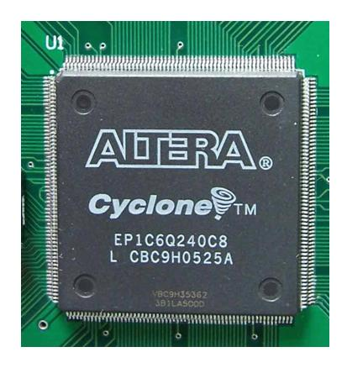
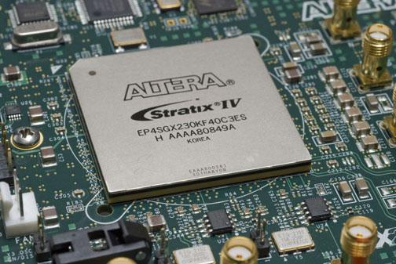
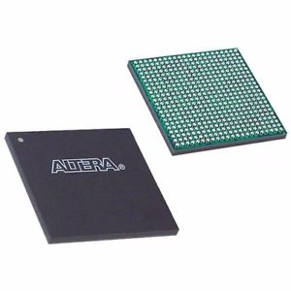
How does an FPGA looks like?
= Quad Flat Pack
= Ball Grid Array

Slide 5

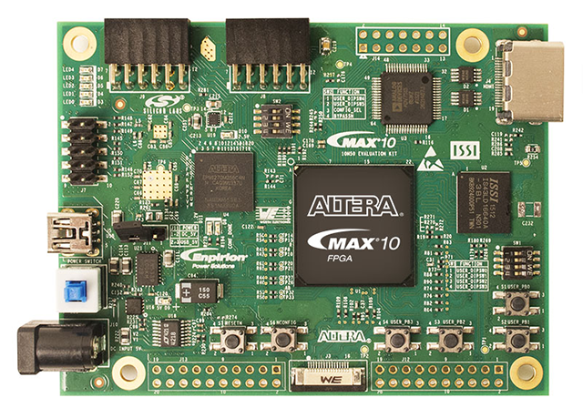

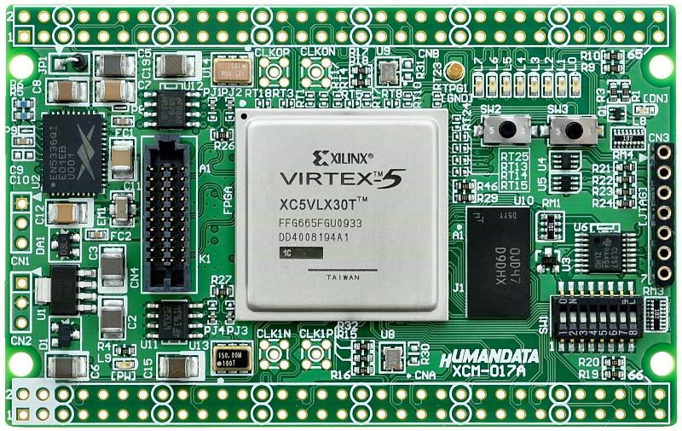


Who manufactures FPGA
Intel (Altera)
Max
Cyclone
Stratix
Arria
Xilinx
Virtex
Spartan
Kintex
Zynq
Design IDE:
Design IDE:

Slide 6

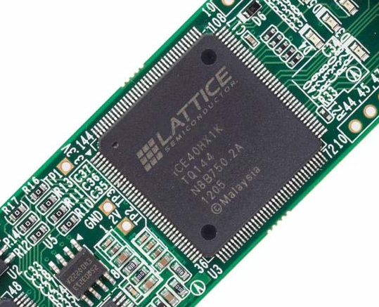

Who manufactures FPGA
Lattice
ECP Series
MachXO3 Series
MachXO & LatticeXP Series
iCE40 Series
Design IDE:

Slide 7

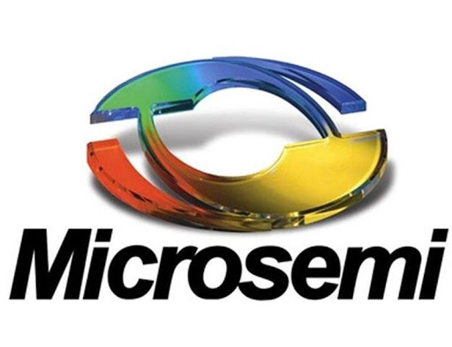
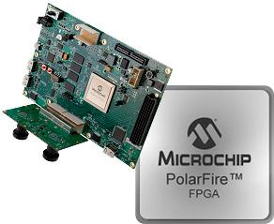


Who manufactures FPGA
Microchip Technology
PolarFire
RT PolarFire Radiation
IGLOO
Design IDE:

Slide 8
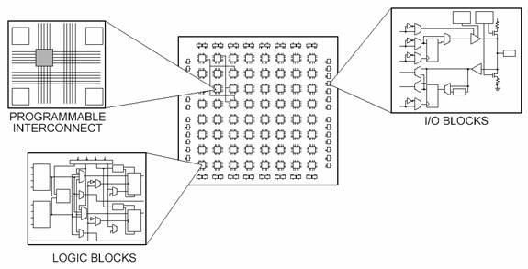
What is Inside an FPGA
Each basic building block with Intel FPFA is called Logic Element(LE) or Adaptive Logic Module(ALM).
All Logic Elements and Other resources are connected with each other with interconnection network.

Slide 9
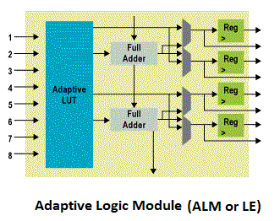
FPGA Architecture
Look-up Table(LUT) : A combinational circuitry, that can implement any N input function.
The preset function value, or LUT-Mask is stored in SRAM bits, and then output is controlled
with the input of LUT. LUT is the computation brain of FPGA.

Slide 10

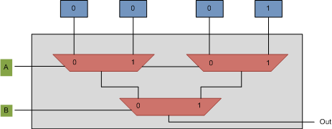
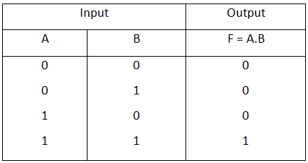
2 input LUT acting as AND gate
SRAM Cells

Slide 11


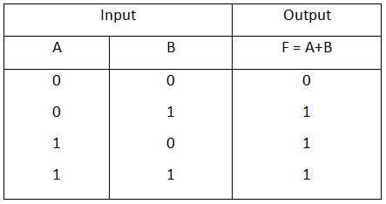
2 input LUT acting as OR gate

Slide 12

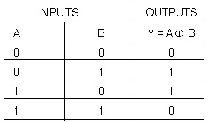
2 input LUT acting as XOR gate

Slide 13
Applications of FPGAs
Historically for prototyping, but now production as well:
Aviation and Aerospace
Communications
Computers
Control
Graphics
Networking and much more.....

